Slide 1
WILD ANIMAL DETECTION IN HUMAN SETTLEMENT AREA
Sincy V.J
Roll.no:47

Slide 2
objectives
The main objective of this project is to avoid common and uncommon dangers from the wild animals.
Protecting the cultivating crops in houses.

Slide 3
Existing system
In existing system, the warning message is sending to authority and authority send back a warning signal to the peoples. But sometimes due to the poor internet connections the warning signals doesnot reach. This makes attacks happen.

Slide 4
PROPOsed system
When animals are detected near the CCTV , it creates a bazar sound . At night to escape from the attack use a LED light.
The animals and humans are detected using deep learning technique.
For creating bazar sound and LED light using some hardwares.
For creating these using ultrasonic, relay module, adrunio, bazar and LED strip.

Slide 5
DESCRIPTION
CCTV camera used to detect the wild animals .
The object detection done through the image processing using deep learning.
Open CV is a library of programing functions mainly aimed at real-time computer vision. Open CV support some models from deep learning frameworks. it is mainly used to do all the operations related to images.
When the object detect near the CCTV creates a bazar sound and turn on the LED light.

Slide 6
Algorithm and dataset
YOLO
YOLO is an abbreviation for the term ‘you only look once’.This is an algorithm that detect and recognizes various objects in a real time.The accident victim detection using YOLO technique .

Slide 7
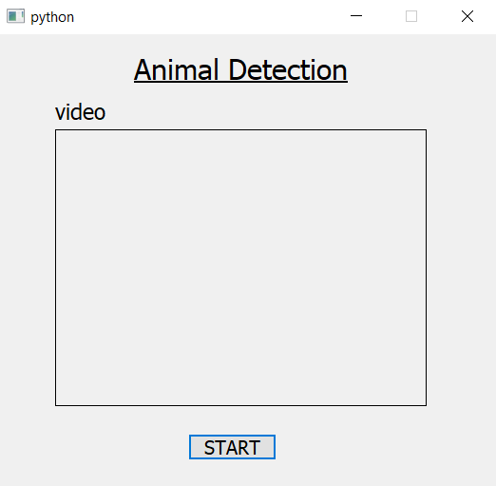
screenshots

Slide 8
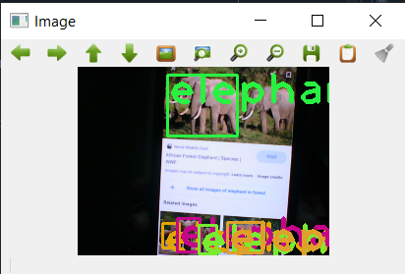
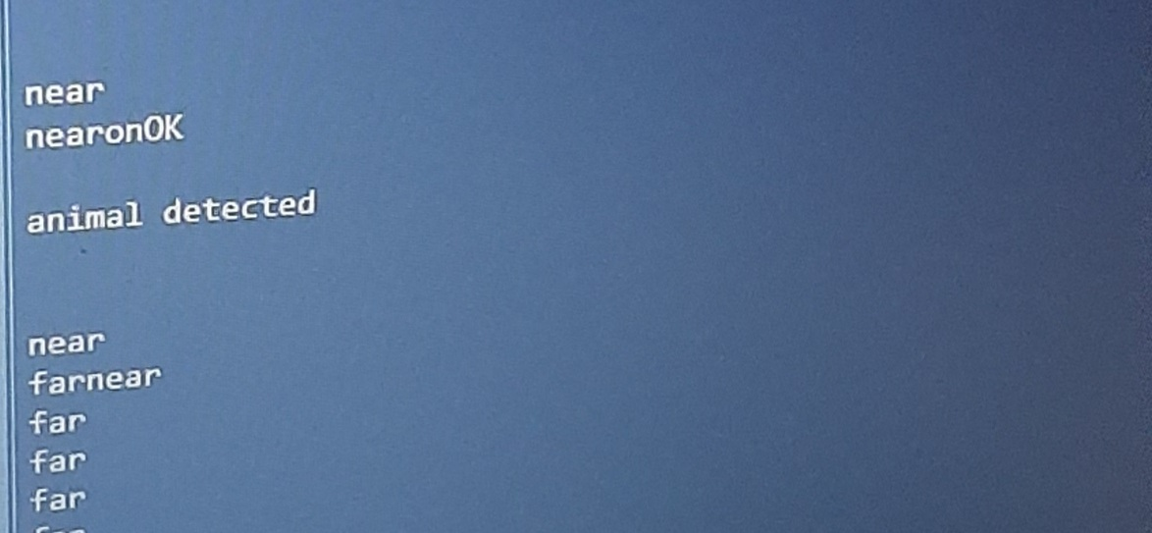

Slide 9
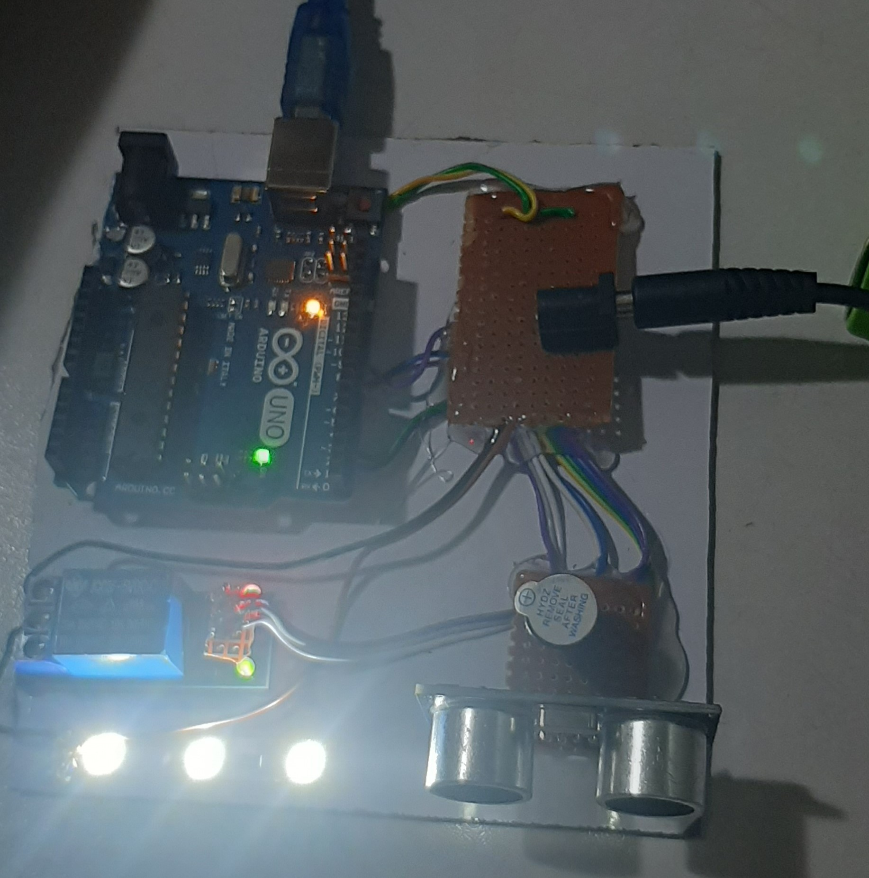

Slide 10
THANKYOU

